Slide 1
Linear Regression

Slide 2




Correlation
The correlation is a quantitative measure to assess the linear association between two variables.
The correlation can be thought of as having two parts: one part that measures the association between variables and another part that acts like a normalizing constant.
The first part is called the covariance.
By def Sum of Square
This is the sum of the product of the differences between the scores and the mean. The estimated variance of Y is
The covariance is similar to the variance except that it is defined over two variables (X and Y) rather than one (Y). We begin with the numerator of the covariance–it is the “sums of squares” of the two variables.
The (estimated) covariance is

Slide 3

The interpretation of the covariance is very similar to that of the variance.
The covariance is a measure of both the direction and the magnitude of the linear association between X and Y.
The covariance has the property that adding a constant to either variable does not change the covariance, i.e
and multiplying either variable by a constant changes the covariance by a multiple of that constant, i.e.,
The property that multiplying by a constant changes the covariance can make interpreting the covariance difficult because we would get a different covariance if we used one measurement as opposed to another (e.g., length in feet v. length in yards).

Slide 4


Correlation cont..
One simple trick fixes this scaling problem.
We know that the standard deviation also has these two properties (adding a constant doesn’t change the standard deviation and multiplying by a constant changes the standard deviation by a multiple of that constant).
So, the standard deviations can be used to “normalize” the covariance such that
=
Dividing by the standard deviation makes the scaling constant c cancel out.
The N - 1 terms in both the numerator and denominator also cancel.
Thus, above equation can be interpreted as a ratio of “sums of squares,” equivalently as the ratio of the covariance to the product of the standard deviations.
Above equation in fact is the definition of the correlation coefficient.
The correlation is the covariance normalized by the standard deviations of the two variables and ranges from -1 to 1. The sample correlation is denoted r_{xy} (sometimes just r for short).
r_{xy}
=
r
=
The correlation squared, denoted r² _{xy}, has an interesting interpretation:
it is the proportion of the variability in one variable that can be accounted for by a linear function of the other variable

Slide 5

t distribution
(sometimes the denominator is called the estimated standard error). The right hand side of Equation can be thought of as a standardized parameter estimate, where the parameter is divided by a measure of it’s sampling variability
Above equation says that whenever an estimate is divided by its estimated standard error (which comes from the theoretical sampling distribution), the resulting ratio follows a t distribution. The t distribution is very similar to the normal distribution except that, for small samples it has longer tails. As the sample size gets large, the t distribution approaches the normal distribution.
Whenever we have a situation for which above Equation applies (that is, we have an estimate divided by its standard error), we can make use of the t distribution. So, the goal in many applications will be to tinker with the details of the problem so we can apply the Equation; in other words, convert something you don’t know how to handle into something you do know how to handle.

Slide 6


One sample t-test
One sample t-test is a statistical procedure used to examine the mean difference between the sample and the known value of the population mean. In one sample t-test, we know the population mean. We draw a random sample from the population and then compare the sample mean with the population mean and make a statistical decision as to whether or not the sample mean is different from the population mean. We can use this analysis, for example, when we take a sample from the city and we know the mean of the country (population mean). If we want to know whether the city mean differs from the country mean, we will use the one sample t-test.
Set up the hypothesis:
A. Null hypothesis: assumes that there are no significant differences between the population mean and the sample mean.
B. Alternative hypothesis: assumes that there is a significant difference between the population mean and the sample mean.
Calculate the standard deviation for the sample by using this formula:
Where
s= std deviation
X(bar) = sample mean
n= number of observation
Calculate the value of the one sample t-test, by using this formula:

Slide 7
The hypothesis test is identical to checking whether the confidence interval includes the value of the null hypothesis. For example, if the CI around a sample mean has a lower bound of .8 and an upper bound of 12.1, I immediately know (without having to do any additional computation) that I would reject the null hypothesis that the population mean µ = 0. The reason is that the CI does not include 0 within its interval. A second example: if the CI around a sample mean has a lower bound of -2.4 and an upper bound of 14.3, I immediately know that I would fail to reject the null hypothesis because the interval does include the value of the null hypothesis.
There is a sense in which the CI is more informative than the hypothesis test because the latter is included in the former. The CI also provides information about variability around the parameter estimate. One could criticize the null hypothesis test for confounding two pieces of information—effect and its variability get lumped into a single number. So a t ratio of 2 could arise in many different ways (e.g., the effect is small and its variability is small, the effect is large and its variability
is large, etc). However, the CI keeps those two terms separate in that one sees the centre of the interval (the estimate) separate from the width of the interval (its variability).

Slide 8
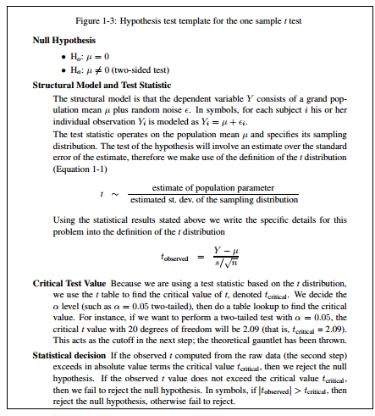

Slide 9
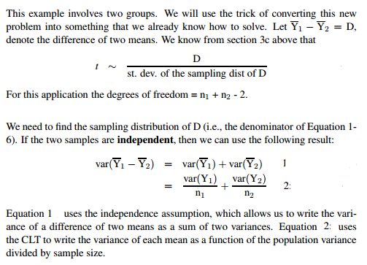
Two sample t test and CI
assumptions in the two sample t test
independent samples
equality of population variances
normality (in practice what tends to be critical is that the distributions be symmetric)
If both groups have equal population variances, denoted
var(Y1) = var(Y2) = var(Y)

Slide 10
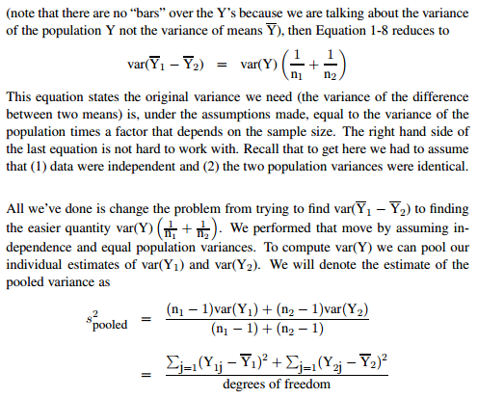
Two sample t test and CI cont..

Slide 11
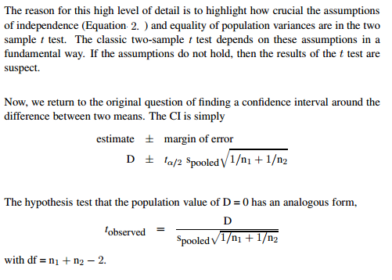
Two sample t test and CI cont..

Slide 12
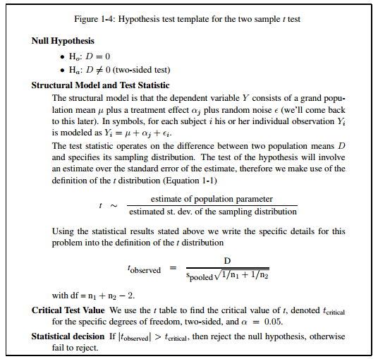
Two sample t test and CI cont..

Slide 13
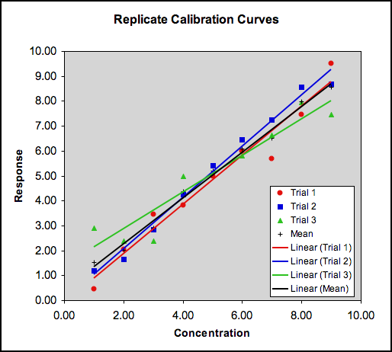
Errors in the Regression Equation:
There is always some error associated with the measurement of any signal.
Even with this precaution, we still need some way of estimating the likely error (or uncertainty) in the slope and intercept, and the corresponding uncertainty associated with any concentrations determined using the regression line as a calibration function.
Multiple calibrations with single values compared to the mean of all three trials. Note how all the regression lines pass close to the centroid of the data.

Slide 14

Uncertainties
The Uncertainty of the Regression:
The spread of the actual calibration points either side of the line of regression of y on x can be expressed in terms of the regression residuals
The greater these residuals, the greater the uncertainty in where the true regression line actually lies.
The uncertainty in the regression is therefore calculated in terms of these residuals. Technically, this is the standard error of the regression,
Note that there are (n − 2) degrees of freedom in calculating . This is because we are making two assumptions in this equation: a) that the sample population is representative of the entire population, and b) that the values are representative of the true y-values. For each assumption, we remove one degree of freedom, and our estimated standard deviation becomes larger.
Another way of understanding the degrees of freedom is to note that we are estimating two parameters from the regression – the slope and the intercept. Therefore, ν = n − 2 and we need at least three points to perform the regression analysis.

Slide 15


The Uncertainty of the Slope:
The slope of the regression line is obviously important, as it determines the sensitivity of the calibration function; that is, the rate at which the signal changes with concentration.
The higher (steeper) the slope, the easier it is to distinguish between concentrations which are close to one another.
The uncertainty in the slope is expressed as the standard error (or deviation) of the slope, s_{b}, and is calculated in terms of the standard error of the regression as:
The corresponding confidence interval for the slope is calculated using the t-statistic for (n − 2) degress of freedom as:
Remember: here n is the number of calibration points used in the regression calculation.

Slide 16

Calculating R
If x and y were linearly correlated, we would expect all the points to fall on a straight line passing through the centroid. As a result, we would expect all x values to be uniformly distributed about ; similarly, all the y values should be uniformly distributed about . The Pearson R is calculated using the formula:
Note from the equation that R is a function of both the x and y residuals from their respective means. If x and y are perfectly correlated in a linear fashion, we would expect the value of R to be +1 if y increases with increasing x (positive slope), or −1 if y decreases with increasing x (negative slope).
Even a high R value of, say, 0.9991 does not necessarily indicate that the data fits to a straight line. The trendline should always be plotted and inspected visually. R2 is more discriminating in this respect, although it no longer indicates the slope of the regression line. This, however, is evident by inspection.

Slide 17






Calculating the Regression Line
The best-fit straight line has the form y = bx + a, where b is the slope and a is the y-intercept of the line. The slope and intercept are given by:
$$=\frac{cov(x,y)}{Var(x)}$$
$$\frac{Syy}{Sxx}$$
= R *
Remember that and represent the centroid (mean x & mean y of the calibration points – use only the values for the linear portion used when calculating R.

Slide 18
Example

Slide 19


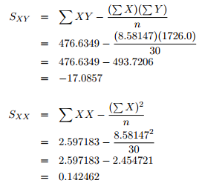
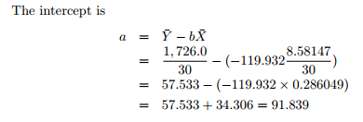

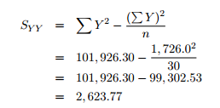

Slide 20
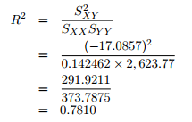
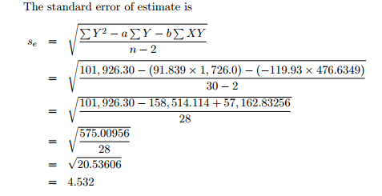
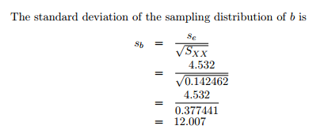
This value of S_{b} can now be used to test for the significance of the slope of the regression line.

Slide 22


The null hypothesis is that there is no relationship between X and Y , that is, that β = 0, where β represents the true slope of the relationship between X and Y .
The alternative hypothesis is that β < 0 since the claim is that the economic status of young families (X) is negatively related to female labour force participation (Y ). The null and alternative hypotheses are
The statistic used to test the relationship is b, and it has mean β and standard deviation sb. The distribution of b is a t distribution with n − 2 = 30 − 2 = 28 degrees of freedom.
At the 0.01 level of significance, for a one tailed t test, the critical t value is -2.468. The region of rejection of H₀ is all t values of -2.468 or lower. The t statistic is
The t value is in the region of rejection, so that b is enough different from 0 to reject the hypothesis of no relationship between X and Y .
There is very strong evidence that β < 0 and that the relationship between the relative economic status of young males and female labour force participation is a negative relationship.

Slide 23
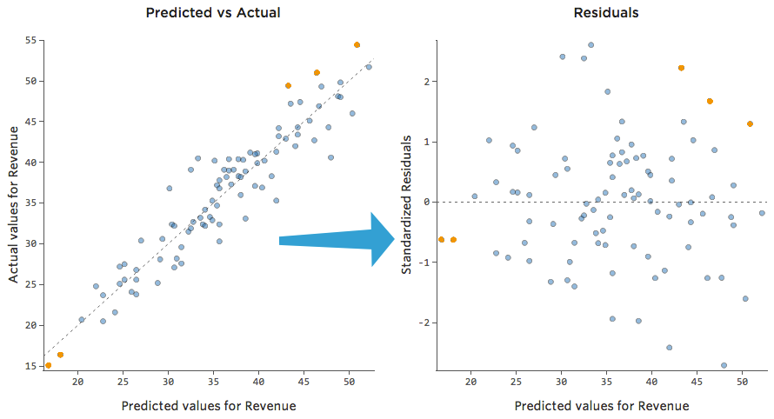
Residual Analysis
Statistical assumptions
The standard regression model assumes that the residuals, or ε’s, are independently, identically distributed (usually called “iid” for short) as normal with µ = 0 and variance σ
The most useful way to plot the residuals, though, is with your predicted values on the x-axis, and residuals on the y-axis.

Slide 24
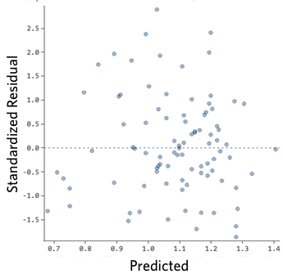
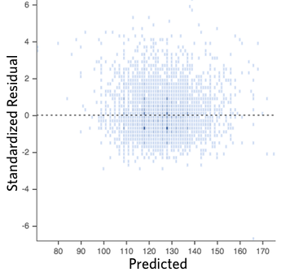
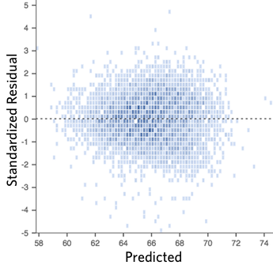
Residual Analysis
Ideally plot of the residuals should look like one of these :
That is,
they’re pretty symmetrically distributed, tending to cluster towards the middle of the plot
they’re clustered around the lower single digits of the y-axis (e.g., 0.5 or 1.5, not 30 or 150)
in general there aren’t clear patterns

Slide 25
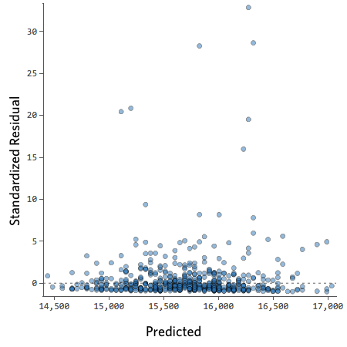
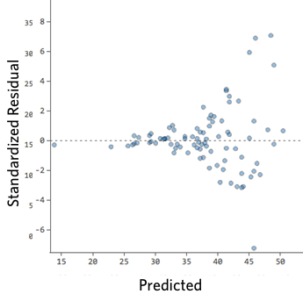
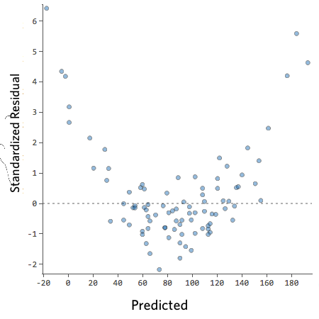
Residual Analysis
These plots aren’t evenly distributed vertically, or they have an outlier, or they have a clear shape to them.
If you can detect a clear pattern or trend in your residuals, then your model has room for improvement.

Slide 26
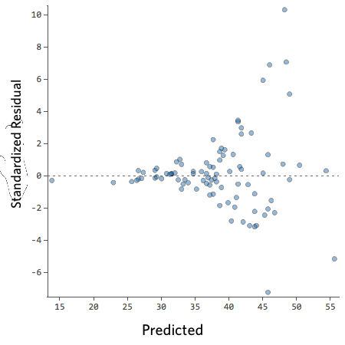
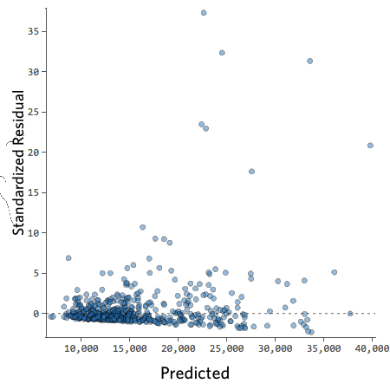
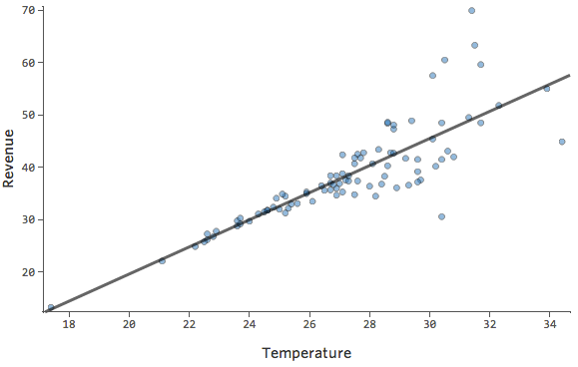
Heteroscedasticity
Problem
These plots exhibit “heteroscedasticity”, meaning that the residuals get larger as the prediction moves from small to large (or from large to small).
How to Fix
The most frequently successful solution is to transform a variable.
Often heteroscedasticity indicates that a variable is missing.

Slide 27
(a) The association is not linear. You check this by looking at the scatter plot of X and Y. If you see anything that doesn’t look like a straight line, then you shouldn’t run a linear regression. You can either transform or use a model that allows curvature such as polynomial regression or nonlinear regression, which we will discuss later. Plotting residuals against the predicted scores will also help detect nonlinearity.
(b) Error terms do not have constant variance. This can be observed in the residual plots. You can detect this by plotting the residuals against the predictor variable. The residual plot should have near constant variance along the levels of the predictor; there should be no systematic pattern. The plot should look like a horizontal band of points.
(c) The error terms must be independent. We can infer the appropriateness of this assumption from the details of project. In some cases you can perform a scatter plot of residuals against time.

Slide 28
(d) Outliers. There are many ways to check for outliers (scatter plot of Y and X, examining the numerical value of the residuals, plotting residuals against the predictor). We’ll also cover a more quantitative method of determining the degree to which an outlier influences the regression line.
(e) Error terms (residuals) are not normally distributed. This is checked by either looking at the histogram of the residuals or the normal-normal plot.
(f) You have the wrong structural model (aka a mispecified model). You can also use residuals to check whether an additional variable should be added to a regression equation.
For example, if you run a regression with two predictors, you can take the residuals from that regression and plot them against other variables that are available. If you see any systematic pattern other than a horizontal band, then that is a signal that there may be useful information in that new variable (i.e., information not already accounted for

Slide 29
What Do r and r² Really Measure?
Before looking at what and do, lets consider what they do not do.
They cannot be used to determine if a data set is linear.
For example, the data in Table describe the relationship between the depth of water in an urn and time as the urn is being emptied. The first question we ask is, “Is the relationship between the variables linear?”
At some time in their lives, most students have gotten a drink from an urn with a stop-cock drain at the bottom. They recognize that a cup fills quickly if the urn is nearly full and very slowly if the urn is nearly empty. If the relationship is linear, then the change in the depth of the liquid in the urn over any fixed interval of time will be the same (to within measurement accuracy).
If students can judge whether the urn is nearly full or nearly empty by how quickly the cup fills, then the relationship cannot be linear. If the change in the dependent variable allows students to predict the value of the independent variable, then the relationship cannot be linear. As one student told me, “Being linear means that you don’t know where you are.” This is an important way to think about linear functions
Correlation Coefficient

Slide 30
If we compute the correlation between Time and Depth for this data, we find that
Correlation Coefficient r =
Which is only 0.0065 away from perfect correlation
However, our own personal experience tells that that this phenomena is not linear, and sufficiently non-linear for us to detect from the simple experience of filling cup from an urn.
The moral here is that we cannot use either r or as a means to determine if a set of data is best modelled by a line.

Slide 31
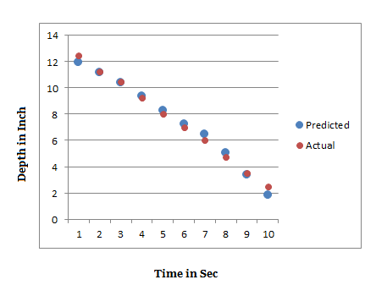
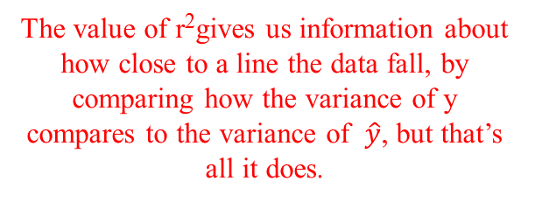
Regression result
The value of r²gives us information about how close to a line the data fall, by
comparing how the variance of y compares to the variance of $\hat{y}$, but that’s all it does.

Slide 32
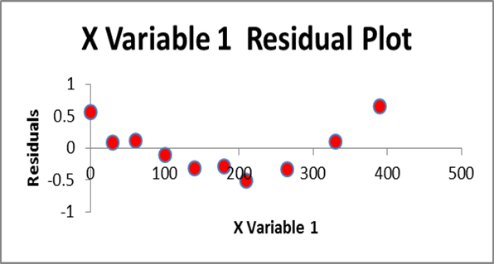
Residual Plot

